Slide 1

Homelessness Prediction
Sean Li

Slide 2

Introduction
With the increasing amount of homeless can we find a way to predict homelessness based on various factors?
Should we use homeless rate or the log of homeless rate in our predictions
Data
The data that we will use is from the U.S. Department of Housing and Urban Development (HUD) which produced a report in 2019 Market Predictors of Homelessness
https://www.huduser.gov/portal/sites/default/files/pdf/Market-Predictors-of-Homelessness.pdf

Slide 3
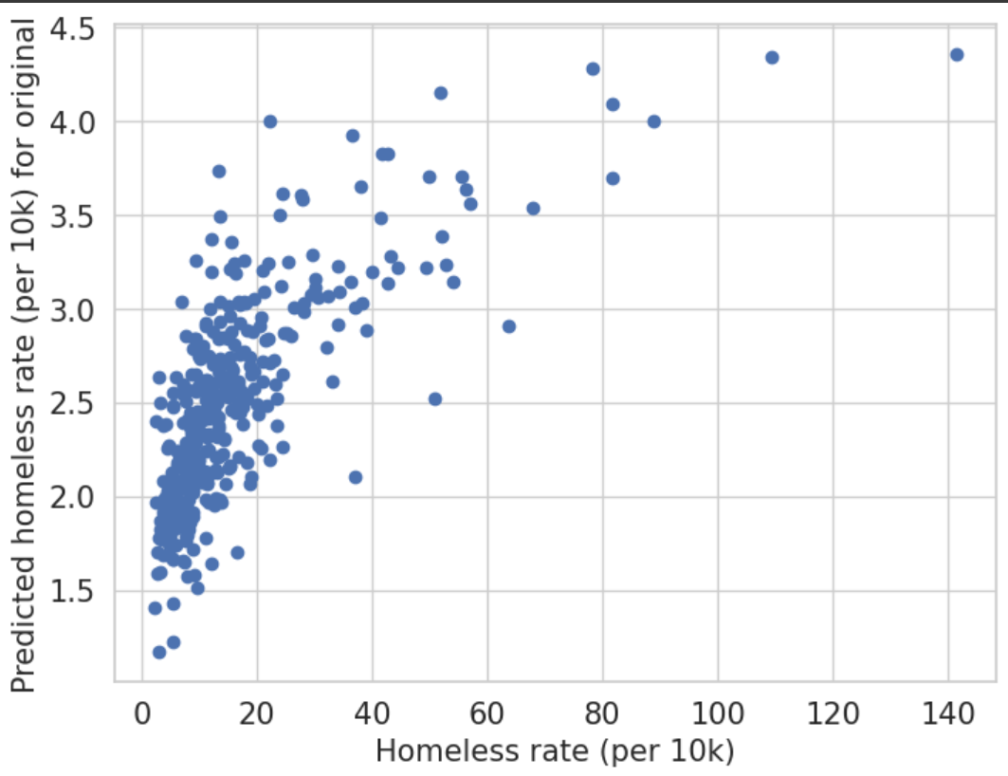
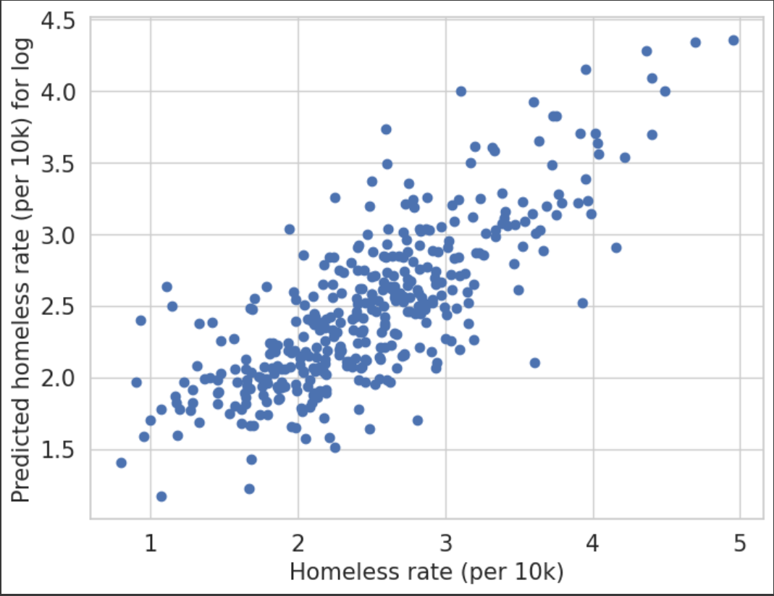
Analysis
Original homeless rate (left) has a skewed distribution
Log homeless rate (right) has a more well spread out linear distribution

Slide 4
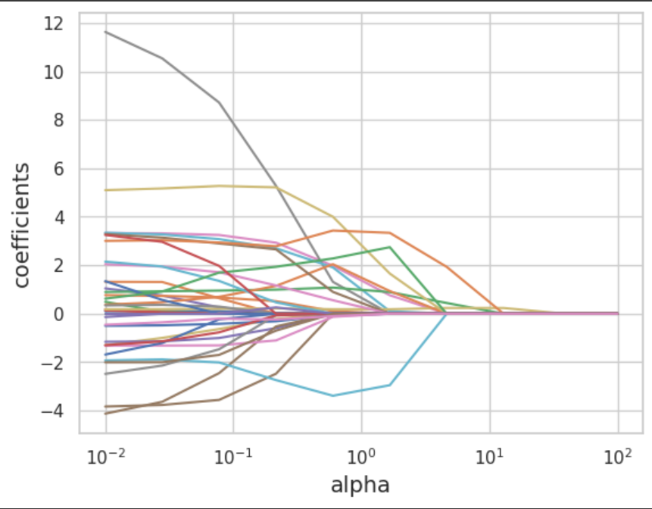
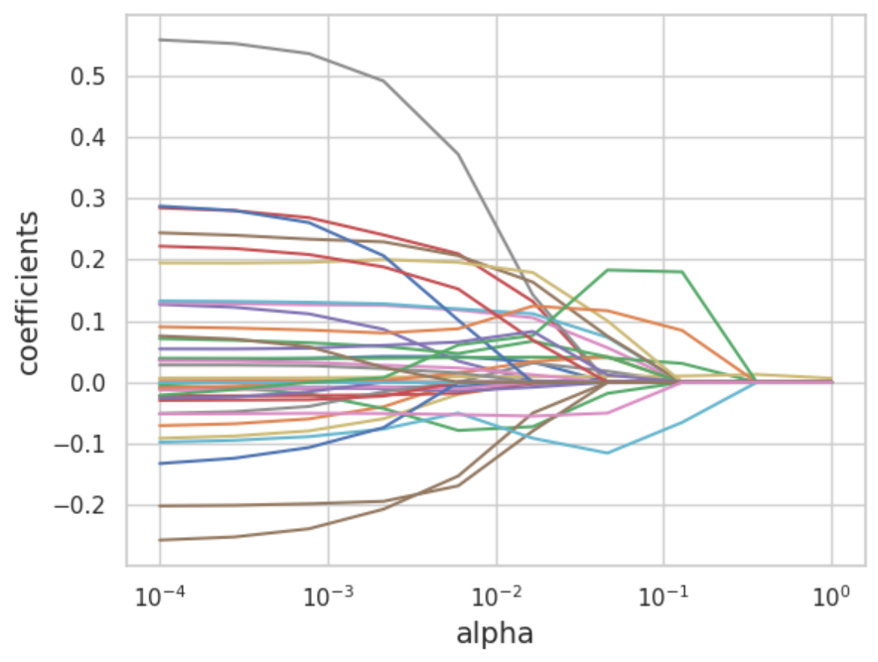
Analysis – Lasso & Ridge
The plots were very similar (displaying Lasso)
Log RMSE value was significantly lower
Log R-Squared slightly higher

Slide 5
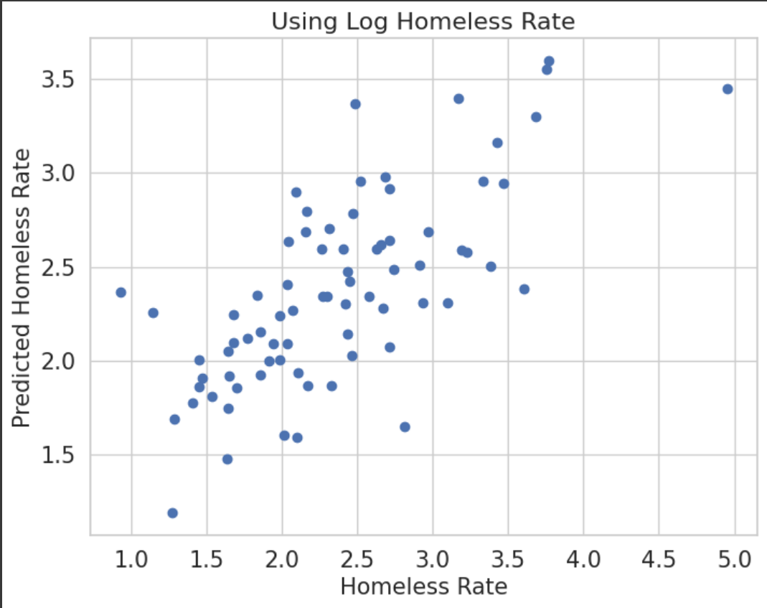
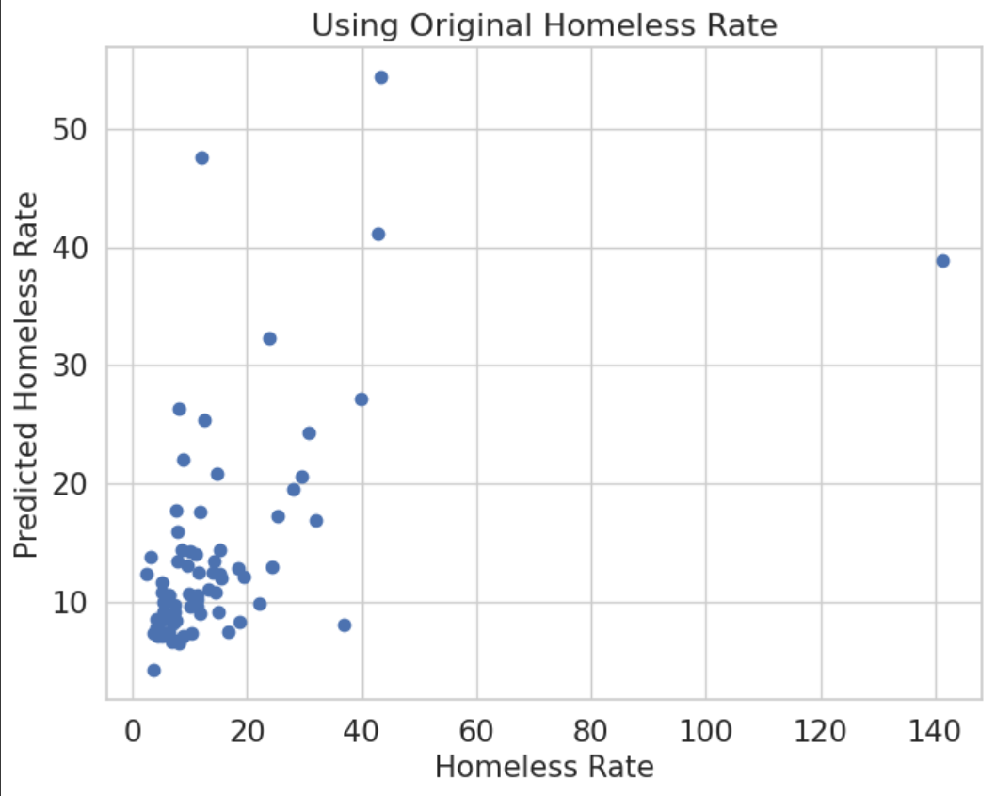
Analysis - XGB
Log homeless rate has a better distribution
Significant skew in original homeless rate
Both have significant outliers

Slide 6
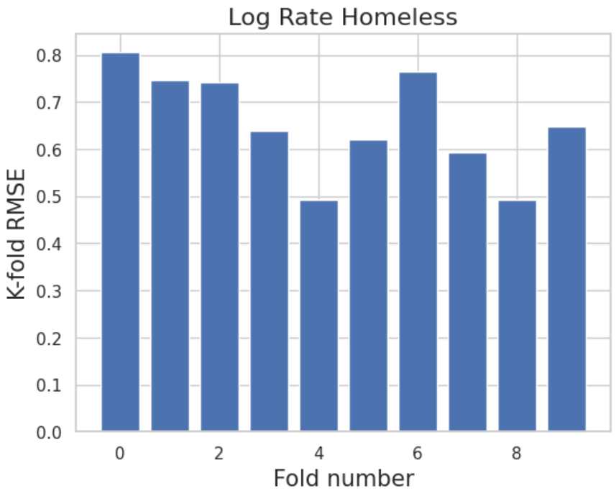
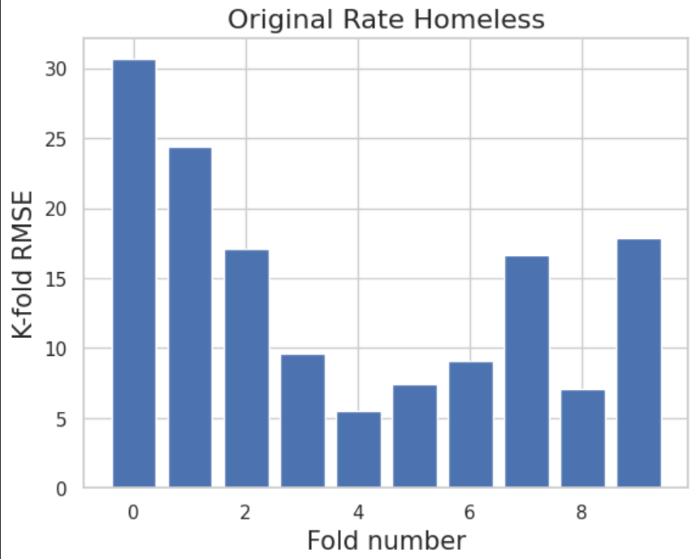
Analysis – Decision Tree
There is a large difference in distribution size
Shape is similar (k = 4 is best)

Slide 7
Conclusion
Log homeless rate had better results
Lower RMSE
Well distributed plots
Misleading due to small numbers
Best to use original homeless rate for clarity

